Slide 1
THE PERSISTENCE OF HEALTH INEQUALITIES IN MODERN WELFARE STATES
Johan Mackenbach
Department of Public Health, Erasmus MC
Rotterdam, Netherlands

Slide 2
INEQUALITIES IN LIFE EXPECTANCY ALONG ROTTERDAM’S METROLINES
Neighbourhood | Life expectancy (men, 2007) | Health expectancy (men, 2007)
Nesselande | 78,8 | 71,9
Ommoord | 77,2 | 69,0
Oosterflank | 76,7 | 68,7
Prinsenland | 77,8 | 69,1
Kralingen-Oost | 78,4 | 70,1
Kralingen-West | 75,9 | 67,7
Stadsdriehoek | 76,5 | 67,7
Cool | 76,0 | 67,0
Delfshaven | 74,3 | 65,3
Spangen | 74,9 | 65,5
Jonker e.a., 2013

Slide 3
INEQUALITIES IN LIFE EXPECTANCY IN THE NETHERLANDS
Kulhanova et al., submitted

Slide 4
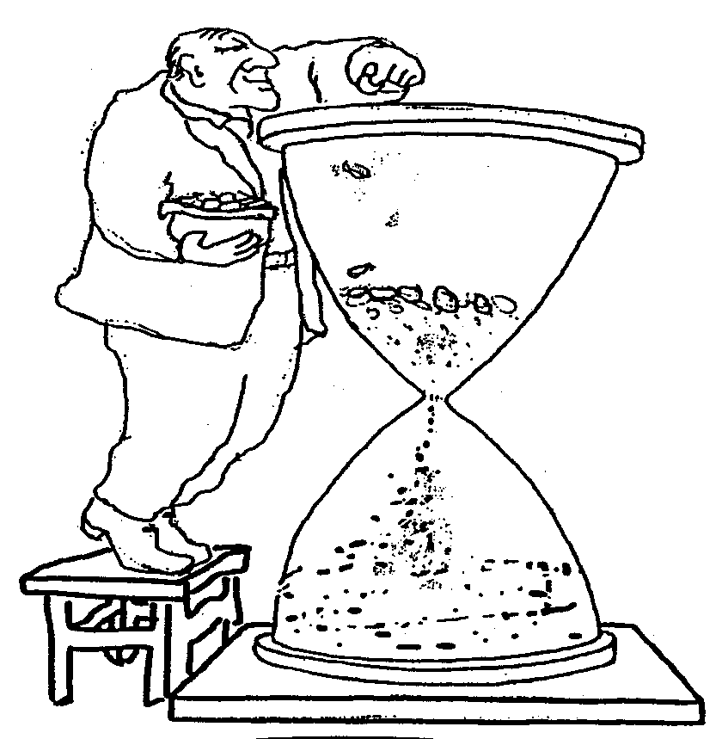
The great paradox of public health:
despite prosperity, more equal income distribution, welfare state, equal access to health care, …
health inequalities persist, and even are widening

Slide 5
TWO RESEARCH STRATEGIES
Zooming in: individuals, and how they differ in socioeconomic position, specific risk factors, and health outcomes e.g. Whitehall, GLOBE, birth cohort studies, …
Zooming out: societies, and how they differ in social structure, risk factor distribution, and health inequalities e.g. international comparative studies

Slide 6
WHAT DO VARIATIONS BETWEEN COUNTRIES TELL US?
Socioeconomic inequalities in mortality are universal and substantial – not smaller in Northern but in Southern Europe
Socioeconomic inequalities in mortality are widening – not responsive to policies aiming to reduce inequalities
Lifestyle risk factors play important role – with variability illustrating robustness of socioeconomic position as “fundamental cause”

Slide 7
VARIATIONS IN MAGNITUDE OF INEQUALITIES IN MORTALITY (M)
Mackenbach et al., submitted

Slide 8
VARIATIONS IN MAGNITUDE OF INEQUALITIES IN MORTALITY (M)
Mackenbach et al., submitted

Slide 9
VARIATIONS IN MAGNITUDE OF INEQUALITIES IN MORTALITY (M)
Mackenbach et al., submitted

Slide 10
VARIATIONS IN MAGNITUDE OF INEQUALITIES IN MORTALITY (W)
Mackenbach et al., submitted

Slide 11
VARIATIONS IN MAGNITUDE OF INEQUALITIES IN MORTALITY (W)
Mackenbach et al., submitted

Slide 12
VARIATIONS IN MAGNITUDE OF INEQUALITIES IN MORTALITY (W)
Mackenbach et al., submitted

Slide 13
WHY DO NORDIC COUNTRIES HAVE LARGER INEQUALITIES THAN SPAIN?
Unpublished data from EURO-GBD-SE project

Slide 14
INEQUALITIES IN SMOKING (M)
Unpublished data from EURO-GBD-SE project

Slide 15
INEQUALITIES IN SMOKING (M)
Unpublished data from EURO-GBD-SE project

Slide 16
INEQUALITIES IN SMOKING (W)
Unpublished data from EURO-GBD-SE project

Slide 17
INEQUALITIES IN SMOKING (W)
Unpublished data from EURO-GBD-SE project

Slide 18
WIDENING RELATIVE INEQUALITIES (M)
Mackenbach et al., submitted

Slide 19
VARIABLE TREND ABSOLUTE INEQUALITIES (M)
Mackenbach et al. submitted

Slide 20
VARIABLE TREND ABSOLUTE INEQUALITIES (M)
Mackenbach et al. submitted

Slide 21
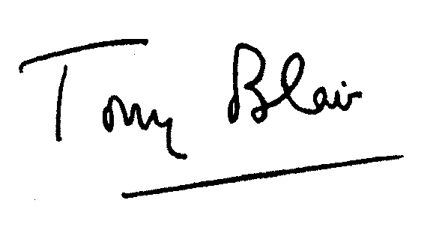
13 YEARS OF LABOUR GOVERNMENT
UNIQUE POLICY EXPERIMENT
IF THIS DID NOT WORK, WHAT WILL?

Slide 22
DID ENGLAND HAVE MORE NARROWING OF ABSOLUTE INEQUALITIES?
Unpublished data from DEMETRIQ project

Slide 23
DID ENGLAND HAVE MORE NARROWING OF ABSOLUTE INEQUALITIES?
Unpublished data from DEMETRIQ project

Slide 24
DID ENGLAND HAVE MORE NARROWING OF ABSOLUTE INEQUALITIES?
Unpublished data from DEMETRIQ project

Slide 25
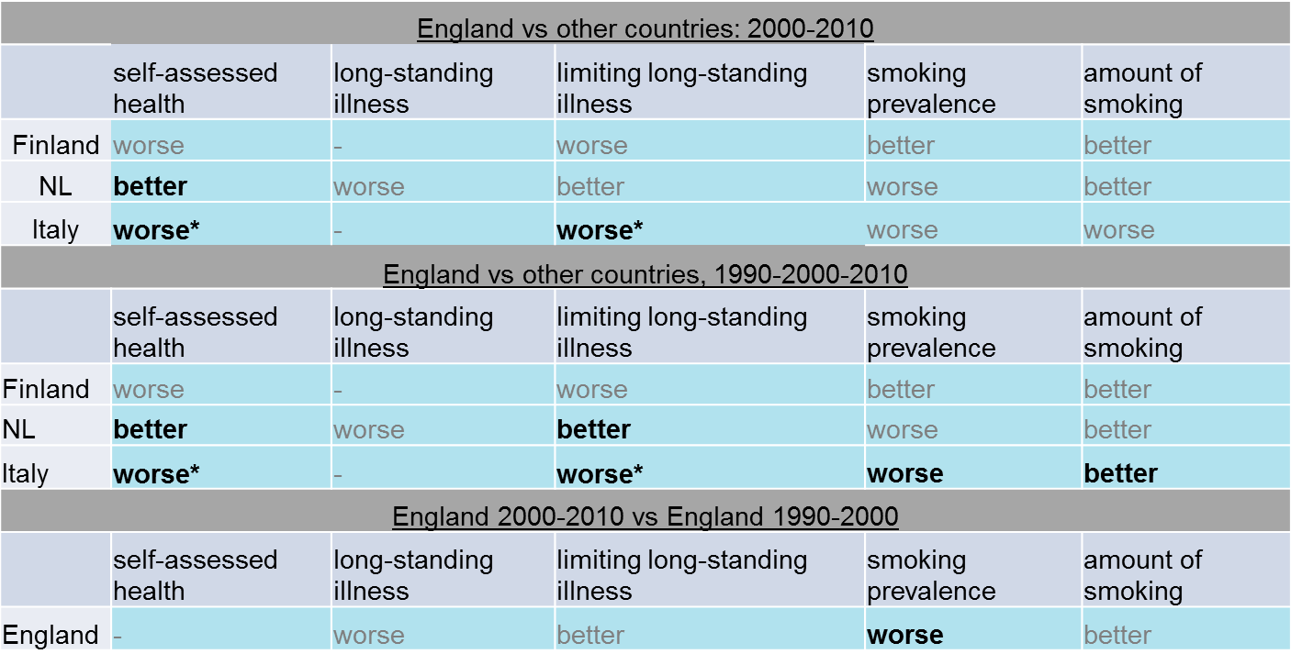
DIFFERENCE-IN-DIFFERENCE ANALYSIS OF INEQUALITIES IN 5 OUTCOMES
Hu et al., in preparation

Slide 26
ISCHEMIC HEART DISEASE (M)
Mackenbach et al. submitted

Slide 27
ROLE OF SMOKING AND OVERWEIGHT (M)
Eikemo et al., submitted

Slide 28
ROLE OF SMOKING AND OVERWEIGHT (W)
Eikemo et al., submitted

Slide 29
PREVENTABLE VERSUS NON-PREVENTABLE CAUSES (M)
Mackenbach et al. submitted

Slide 30
PREVENTABLE VERSUS NON-PREVENTABLE CAUSES (M)
Mackenbach et al. submitted

Slide 31
PREVENTABLE VERSUS NON-PREVENTABLE CAUSES
Median Mortality Relative Risk 19 European populations, 2000s, men and women
 | Men |  | Women
 | Obs. | Median RR | Obs. | Median RR
All causes of death | 385 | 1,90 | 343 | 1,67
All preventable causes | 276 | 2,15 | 244 | 1,90
Amenable to behaviour change | 161 | 2,35 | 146 | 2,30
Amenable to medical intervention | 118 | 1,82 | 127 | 1,90
Amenable to injury prevention | 51 | 1,94 | 38 | 1,40
All non-preventable causes | 109 | 1,53 | 99 | 1,43
Mackenbach et al. submitted

Slide 32
PREVENTABLE VERSUS NON-PREVENTABLE CAUSES
Median Mortality Relative Risk 19 European populations, 2000s, men and women
 | Men |  | Women
 | Obs. | Median RR | Obs. | Median RR
All causes of death | 385 | 1,90 | 343 | 1,67
All preventable causes | 276 | 2,15 | 244 | 1,90
Amenable to behaviour change | 161 | 2,35 | 146 | 2,30
Amenable to medical intervention | 118 | 1,82 | 127 | 1,90
Amenable to injury prevention | 51 | 1,94 | 38 | 1,40
All non-preventable causes | 109 | 1,53 | 99 | 1,43
Mackenbach et al. submitted

Slide 33
ROBUSTNESS OF HEALTH INEQUALITIES = ROBUSTNESS OF SOCIAL INEQUALITY

Slide 34
WHY HEALTH INEQUALITIES PERSIST DESPITE THE WELFARE STATE
Inequalities in access to material and immaterial resources have not been eliminated by the welfare state
Social mobility has become more sensitive to personal characteristics that are associated with health (mental health, cognitive ability, …)
Welfare state is not effective against determinants of disease that are linked to consumption behavior
Mackenbach 2012

Slide 35
REDISTRIBUTIVE EFFECTS OF THE WELFARE STATE, NETHERLANDS
Lifetime wages before government intervention, vs. lifetime welfare after tax, cash transfers and non-cash benefits, in thousands of Euros, Netherlands, ca. 2002
Ter Rele 2007

Slide 36
RISE OF INTERGENERATIONAL SOCIAL MOBILITY
RMO 2011

Slide 37
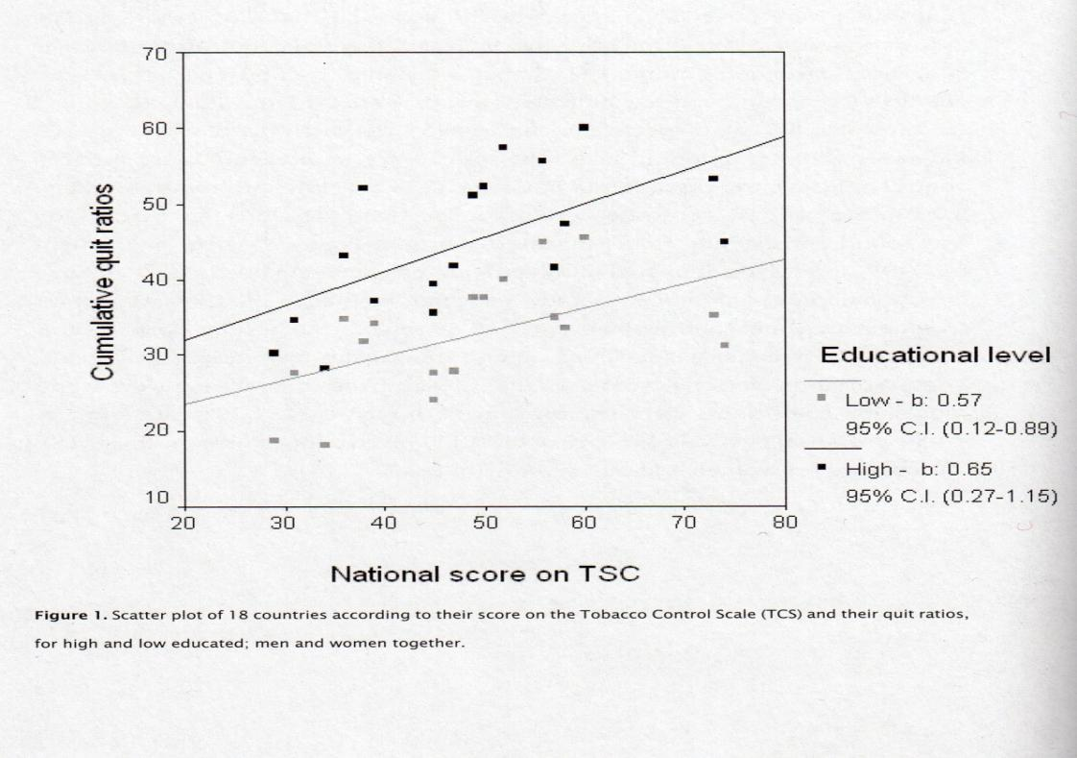
TOBACCO CONTROL AND INEQUALITIES IN QUIT RATIOS
Schaap et al. 2008

Slide 38
SOBERING CONCLUSIONS
Magnitude of socioeconomic inequalities in mortality varies substantially between countries, suggesting great potential for reduction – but smaller inequalities do not reflect more effective policies
Recently, absolute mortality inequalities have started to decline in some countries – but do not reflect success of national programs to reduce health inequalities, and relative inequalities continue to rise
Health inequalities are remarkably robust across time and place – we need better ideas for addressing inequalities in consumption behavior and/or their fundamental causes

Slide 39
THANK YOU!
Mackenbach JP. The persistence of health inequalities in modern welfare states: The explanation of a paradox. Soc Sci Med 2012;75:761-769.
Eikemo TA et al. How can inequalities in health be reduced? A study of 6 risk factors in 21 European populations. Submitted for publication
Kulhanova I et al. Why does Spain have smaller inequalities in mortality? Eur J Publ Health (in press)
Mackenbach JP et al. Widening inequalities in mortality in mortality: a study of 3.2 million deaths in 13 European countries. Submitted for publication
Mackenbach JP et al. Variations in the relation between education and cause-specific mortality in 19 European populations: a test of the “fundamental causes” theory of social inequalities in health. Submitted for publication

